Slide 1

Azure Developer – Virtual Mentored Program
Azure App Service
Notes:
Mandatory
ACTION: Adjust title to fit your course.

Slide 2
The Value Proposition

Slide 3
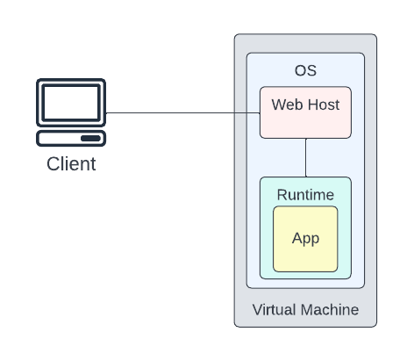
Deploying Web Apps – the “Hard(er)” Way
Responsible for management of OS
Responsible for installation & configuration of a web hosting framework
Responsible for installation & configuration of a runtime
Responsible for installation & configuration of the app itself
Notes:
OS: Patches, security updates, etc.
Web Hosting FW: So application can be reached over the Internet/network from external clients
Runtime: like Java, .NET, .NET Core, etc.

Slide 4
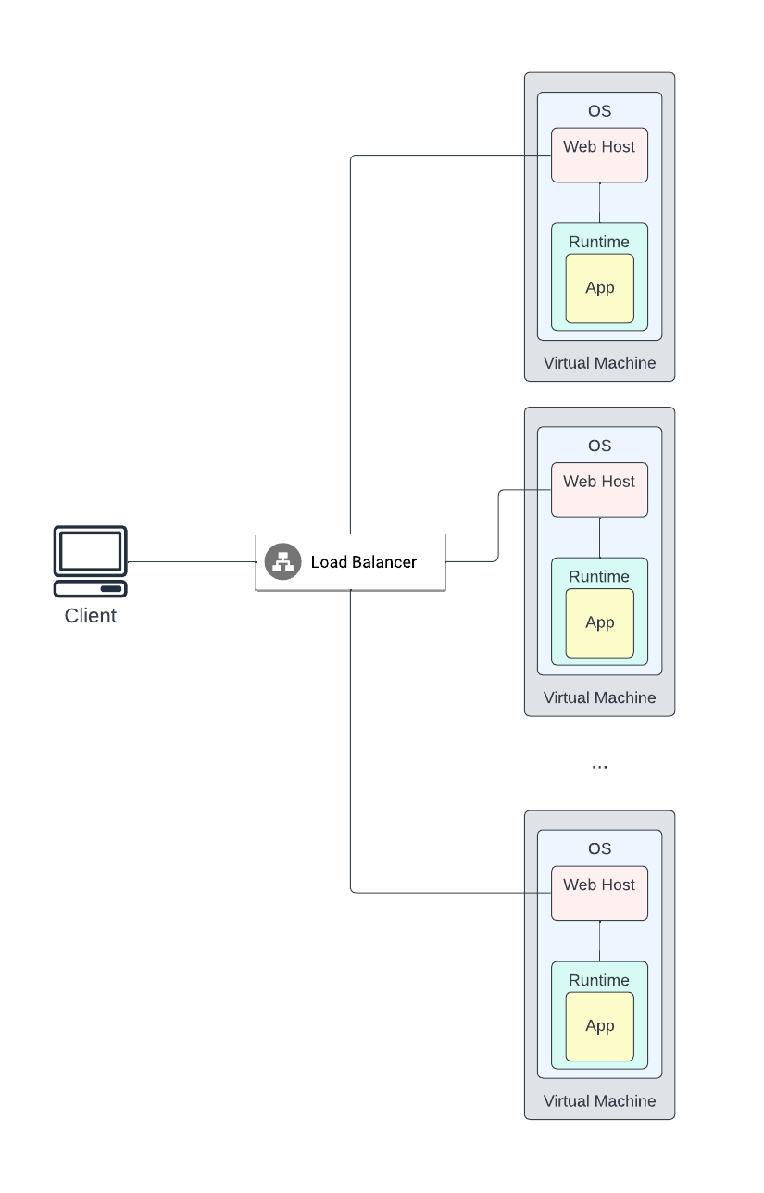
What If We Need More Instances?
Now our responsibilities (and associated effort) gets multiplied by N
Also, need new components (like a load balancer)
Need custom domain management
Likely need an SSL/TLS framework to support encryption
Increases complexity
Maybe there’s a better way?
Notes:
This would apply whether on-premises or being hosted in the Cloud on VM’s and using VMSS (in Azure) – this is IaaS. More granular control but also more operational responsibility.
For some use cases, this is the approach to take.

Slide 5
Azure App Service + Plan

Slide 6
Azure App Service
Provides an HTTP-based managed service for hosting web apps and APIs
Supports multiple development languages
Relieves operational burden when hosting & exposing a web-enabled workload
Configuration managed via App Service Plan
Notes:
PaaS offering

Slide 7
Azure App Service Plan
App Service always runs in App Service Plan
Defines the compute resources used to host and service your web app or API
Dictates level of isolation for your workload
Also, used to expose key capabilities like scaling, deployment, encryption, etc.

Slide 8
Azure App Service Plan – Pricing Tiers
Shared Compute
Dedicated Compute
Isolated

Slide 9
Azure App Service Plan – Shared Compute
Enables access to 2 base tiers (Free & Shared)
Runs app on same underlying Azure VM used to host apps from other customers
Enforces CPU quotas
Resources cannot scale out
Notes:
Limited in capability but cheaper – always a tradeoff

Slide 10
Azure App Service Plan – Dedicated Compute
Enables access to Basic, Standard, Premium, PremiumV2, and PremiumV3 tiers
Features app execution on dedicated Azure VMs
Only apps in same App Service Plan share compute
As you move higher through tiers, provides access to more VM instances for scale-out
Notes:
Talk about diffs between scale up & scale out

Slide 11
Azure App Service Plan – Isolated
Enables access to Isolated and IsolatedV2 tiers
Run dedicated Azure VMs on dedicated Azure Virtual Networks
Provides both network as well as compute isolation
Also, provides maximum scale-out capabilities
Notes:
Most powerful/feature-rich but, as a result, most expensive

Slide 12
Azure App Service Plan – App Service Features
The higher the tier, the more features are available
See https://azure.microsoft.com/en-us/pricing/details/app-service/windows/ for a breakdown

Slide 13
Azure App Service + Plan – Key Features
Infrastructure managed for you (PaaS)
Depending on tier, multiple nodes and high availability supported
Automatic & manual scaling (again depending on tier)

Slide 14
Azure App Service + Plan – Key Features
Direct integration with multiple IDEs
Direct integration with multiple CI/CD pipeline types
Provides integration with other Azure Services (e.g., integration with an Azure SQL database)

Slide 15
Demo – Create App Service Plan
Notes:
Can be created standalone and then associated with App Services or can be created at time of App Service creation.
Can be created using Portal, Azure CLI, Powershell
Create via Portal and demonstrate various features/properties
Create via CLI → az appservice plan create --name appservice-plan-cli --resource-group appsvc-demo

Slide 16
Azure Web Apps

Slide 17
Azure Architecture
Management Group
Subscription
Resource Group
Resource

Slide 18
Azure Web Apps
Resource Group
App Service Plan
Runtime
Web App

Slide 19
Azure Web Apps
All resources in Azure reside within a Resource Group
Resource Group
App Service Plan
Runtime
Web App

Slide 20
Azure Web Apps
App Service Plan provides the compute for your Web App
Resource Group
App Service Plan
Runtime
Web App

Slide 21
Azure Web Apps
Multiple runtimes/languages are supported for hosting
Resource Group
App Service Plan
Runtime
Web App
Notes:
Java, .NET, Ruby, etc.

Slide 22
Azure Web Apps
Represents your application’s source code
Resource Group
App Service Plan
Runtime
Web App
Notes:
We’ll see later that the Web App can also be hosted as a static site or as a container

Slide 23
Demo – Create Simple Web App
Notes:
Execute quick start at https://docs.microsoft.com/en-us/azure/app-service/quickstart-dotnetcore?tabs=net60&pivots=development-environment-vscode
Run through:
Create new app in GitHub folder
Test locally
Push to Azure App Service (F1) → azure-web-apps (RG) and azureaspnetcorewebapp (App Service name)
Test on Azure
Update page and redeploy
Test update on Azure
Go into portal and look at various tabs (push to Standard)
Explore Deployment Center, Configuration, AuthN/AuthZ, Custom Domains, Scaling

Slide 24
Demo – Create REST API
Notes:
Execute https://docs.microsoft.com/en-us/azure/app-service/app-service-web-tutorial-rest-api

Slide 25
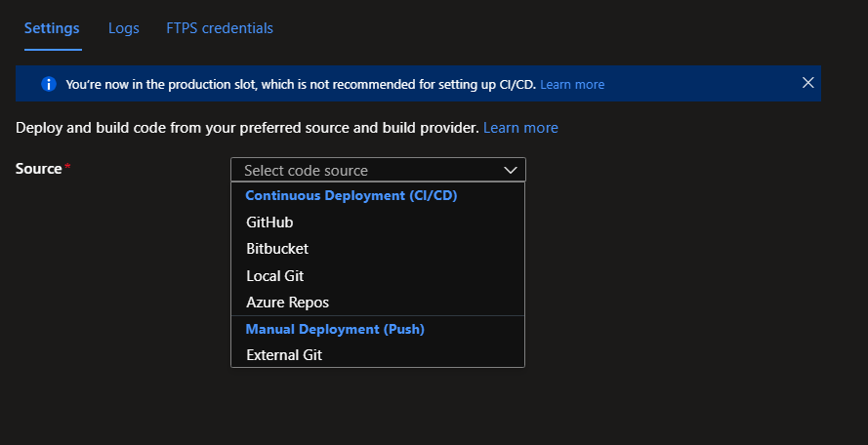
Deployment Center

Slide 26
Deployment Center
Supports manual deployment
More interesting use case is deployment as part of an automated CI/CD flow (e.g., GitHub Actions)
Supports secure FTP for deploy
Logs provide information on deployment status

Slide 27
Demo – Deployment Center
Notes:
https://docs.microsoft.com/en-us/azure/app-service/deploy-github-actions?tabs=applevel
Walk through above – demo connectivity to GitHub Actions, show secret, etc. Demonstrate check-in and automatic execution. Build on simple web app.

Slide 28
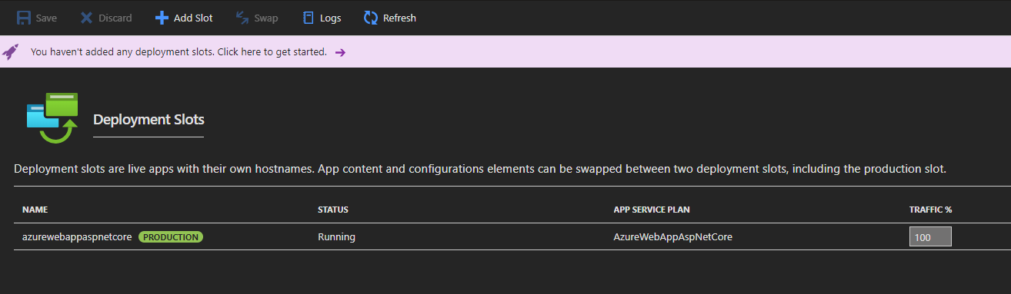
Deployment Slots

Slide 29
Deployment Slots
Provide live versions of the app with a unique host name
Application content & configuration can be swapped between two slots – e.g., testing in staging and then swapping to production
Requires that app be running in Standard, Premium, or Isolated tiers

Slide 30
Deployment Slots – Benefits
Allows validation of application changes in a non-production environment before enabling for production access
Deploying an app to a slot and then swapping into production “warms up” the app instances (performance)
Can swap back to get to last known good version or can split traffic by % to do A/B testing
New slot has its own management page and can be deployed from a different repo or branch

Slide 31
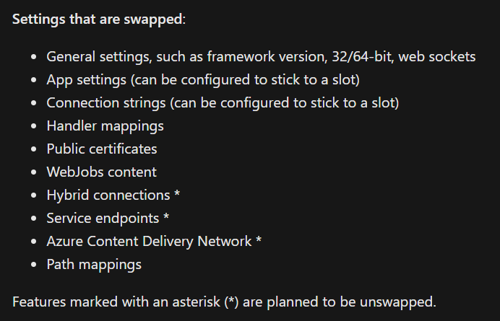
Deployment Slots – On Swap
Source: https://docs.microsoft.com/en-us/azure/app-service/deploy-staging-slots

Slide 32
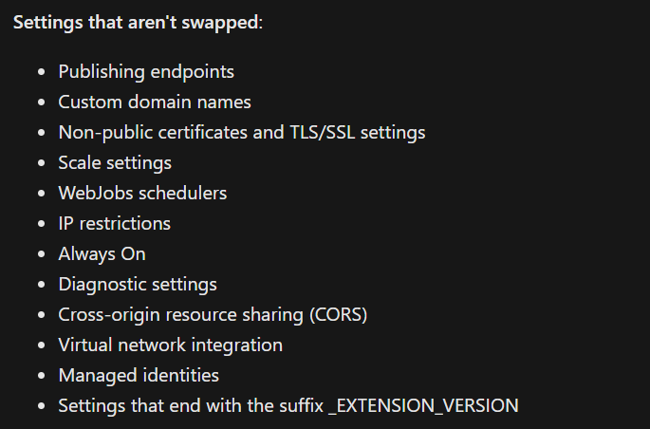
Deployment Slots – On Swap
Source: https://docs.microsoft.com/en-us/azure/app-service/deploy-staging-slots

Slide 33
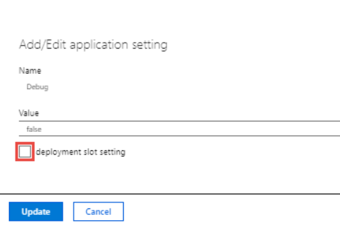
Deployment Slots – On Swap
Application settings or connection strings can be configured to be “sticky” to a specific slow (not swapped)
In the setting definition for a slot, you can mark the setting as a deployment slot setting
Source: https://docs.microsoft.com/en-us/azure/app-service/deploy-staging-slots

Slide 34
Demo – Deployment Slots
Notes:
https://docs.microsoft.com/en-us/azure/app-service/deploy-staging-slots
Walk through above – map slot to a new branch and demo auto push / split traffic in different ways → then show swap. Build on simple web app.

Slide 35
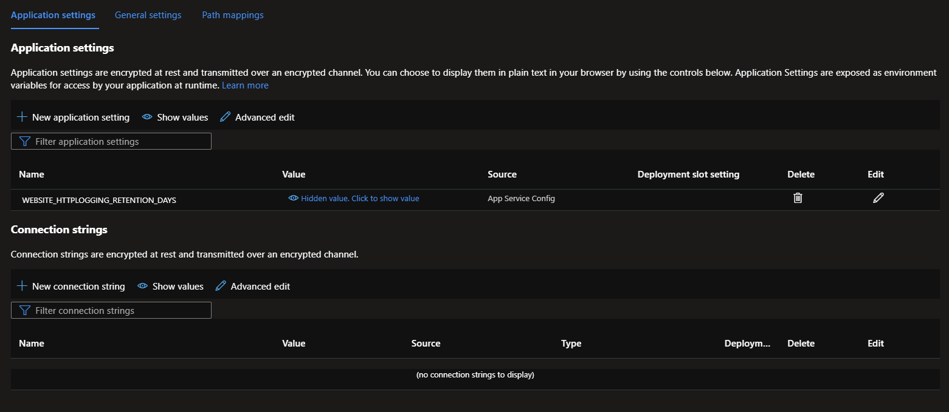
Configuration – Application Settings

Slide 36
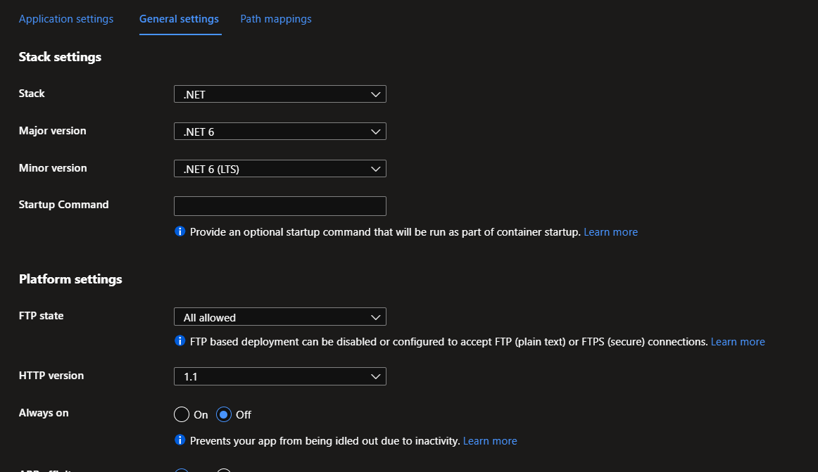
Configuration – General Settings

Slide 37
Demo – Configuration
Notes:
https://docs.microsoft.com/en-us/azure/app-service/tutorial-java-spring-cosmosdb
Walk through above – demo configuration settings/connection strings

Slide 38
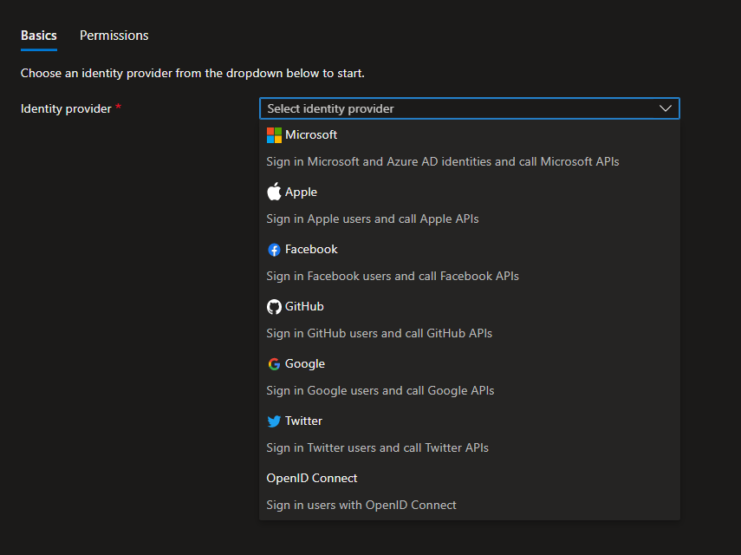
Authentication

Slide 39
Authentication
Azure App Service has built in support for user AuthN & AuthZ
Supports integration with multiple identity providers (Azure AD, social media, etc.)
Supports robust access tokens
Enables service-to-service security using token authentication

Slide 40
Demo – Authentication
Notes:
https://docs.microsoft.com/en-us/azure/app-service/tutorial-auth-aad
Walk through above – demo authentication

Slide 41
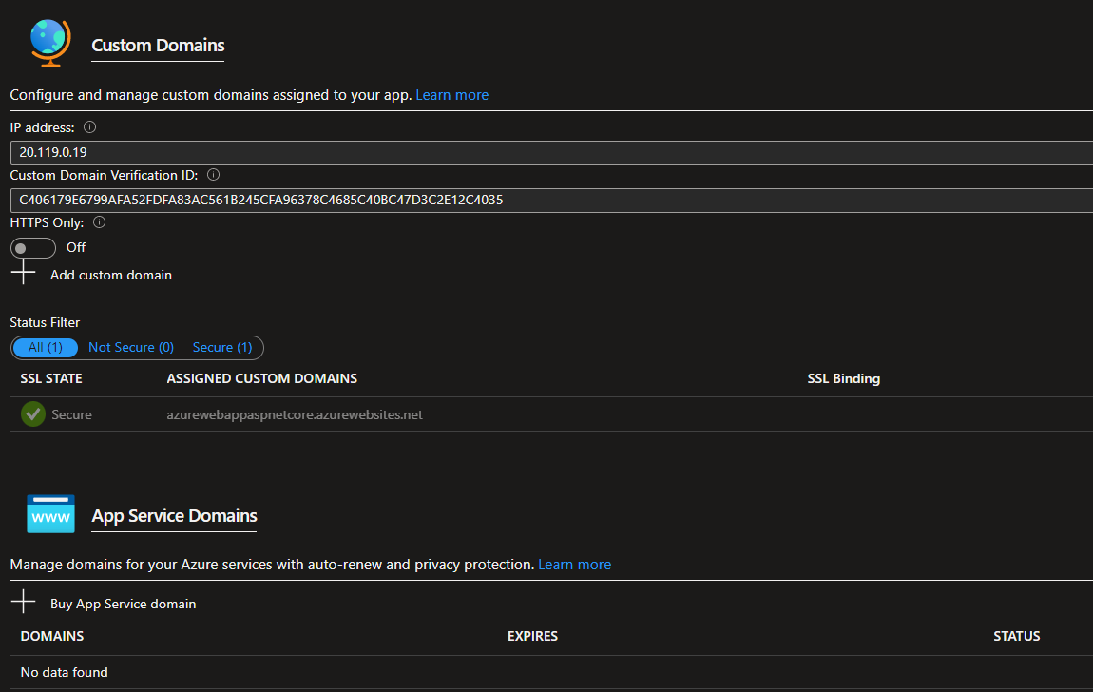
Custom Domains

Slide 42
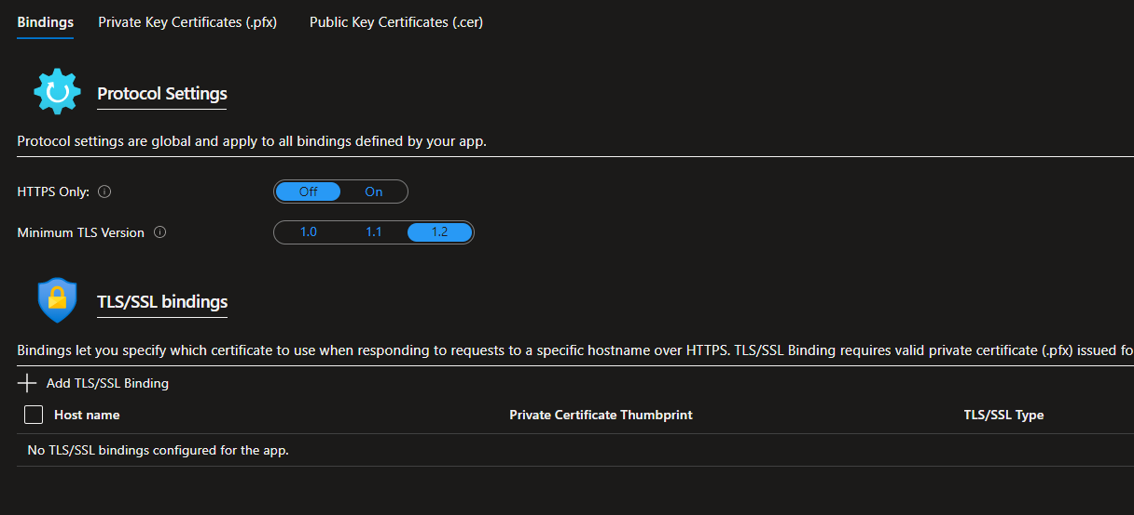
TLS/SSL Settings

Slide 43
TLS/SSL Settings
You can associate (bind) a certificate to the App Service for managing TLS
Can use SNI (Server Name Indication) SSL – allows multiple certs to secure multiple domains on the same IP (broad browser support)
Or can use IP SSL – only one cert can be used to secure a dedicated (and static) public IP address
Via settings, able to enforce HTTPS and TLS version (1.2 recommended)

Slide 44
Demo – TLS/SSL Settings
Notes:
https://docs.microsoft.com/en-us/azure/app-service/configure-ssl-bindings
Walk through above – demo cert

Slide 45
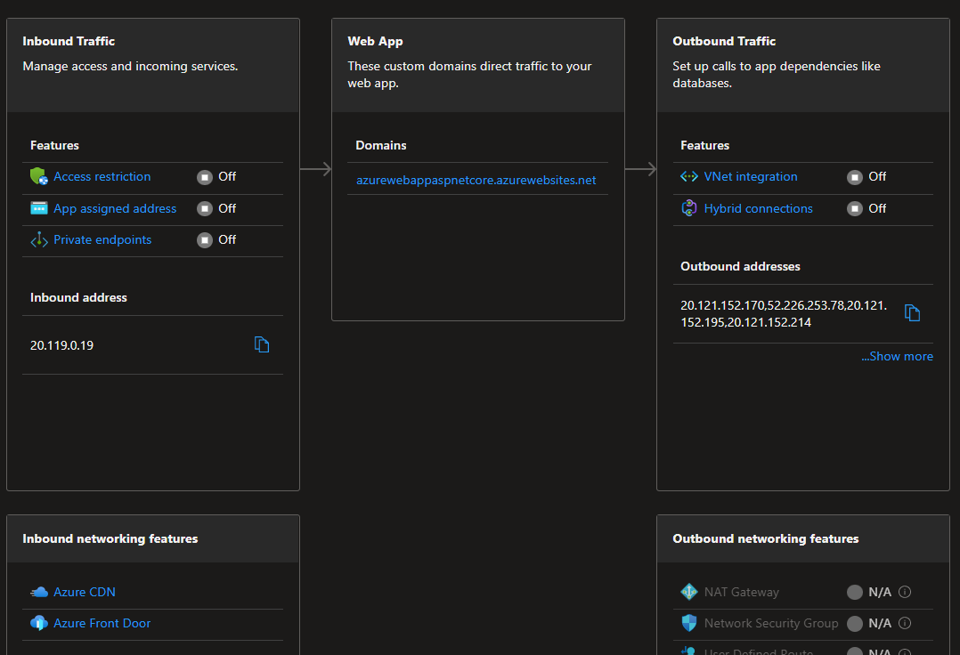
Networking

Slide 46
Networking
Network traffic can be isolated via Virtual Network integration
This is different from the previous discussion on Isolated Pricing tier
Using a virtual network and private endpoints, traffic between an App Service and back-end support services can be secured
Prevents public access to back-end services; only App Service will be configured for access

Slide 47
Demo – Networking Isolation
Notes:
https://docs.microsoft.com/en-us/azure/app-service/tutorial-networking-isolate-vnet
Walk through above – demo isolation

Slide 48
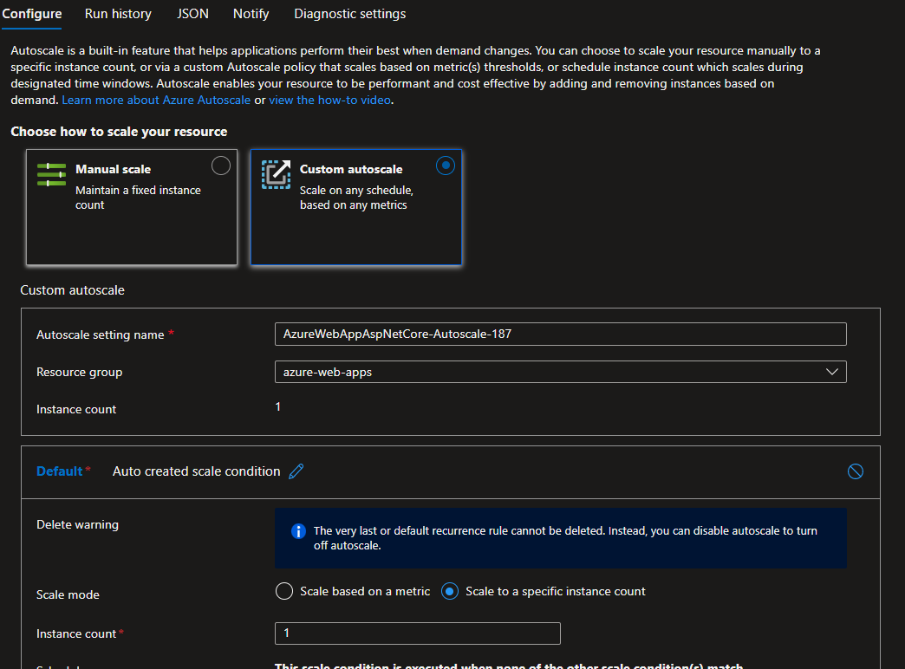
Scaling Out

Slide 49
Demo – Static Site
Notes:
https://docs.microsoft.com/en-us/azure/app-service/quickstart-html
Walk through above – demo static deployment

Slide 50
Demo – Container App
Notes:
https://docs.microsoft.com/en-us/azure/app-service/tutorial-custom-container?pivots=container-linux
Walk through above – demo container deployment

Slide 51
Lab – Java Deployment to App Service
https://docs.microsoft.com/en-us/azure/app-service/quickstart-java
Notes:
Supports different approaches (including IntelliJ)

Slide 52




Thank you!
If you have additional questions, please reach out to me at:
(asanders@gamuttechnologysvcs.com)

